Slide 1

CA Hate Crime 2001-2021
Notes:
Brittney
Hi Class! We are Pod D. I’m Brittney and I will be presenting alongside my team members Le, Jackie and sheila. we will be presenting on Hate Crimes Within California during the years of 2001 -2021

Slide 2
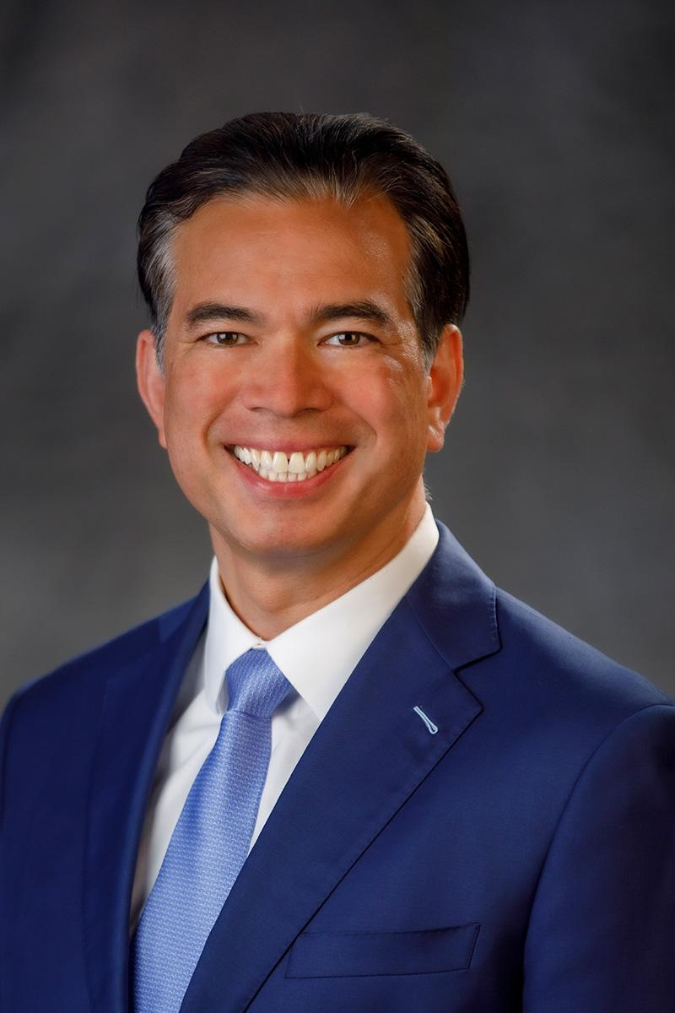

Introduction
Client:
Attorney General of California
Rob Bonta
The dataset
Provided by California Department of Justice
Data such as bias type, location, number of victims, & etc.
Quick Facts
In 2020, 15,138 law enforcement agencies submitted data on hate crimes
In 2020, there were 1,340 reported hate crimes within California
Goals: To Identify Different Bias Trends within Hate Crimes
Where do hate crimes most often take place?
What factors lead to hate crimes?
How can we reduce the amount of hate crimes?
Notes:
Brittney
Just a little background on our stakeholders and dataset. We chose to do find our own data set and found data on hate crimes from the California Department of Justice. Our main stakeholder/client would be the Attorney General of California, Rob Bonta. The data set included information such as bias type, location, number of victims, & more. Here are some quick facts

Slide 3

Points of Discussion
What is a Hate Crime?
Total Number of Victims Affected by Hate Crime Per Year
Different Bias Types Within California
Location of Hate Crimes Around California
Total Number of Weapon Types used in Hate Crimes
Notes:
brittney

Slide 4
What is a Hate Crime?
Notes:
brittney

Slide 5

What is a Hate Crime?
Hate Crime: At the federal level, a crime motivated by bias against race, color, religion, national origin, sexual orientation, gender, gender identity, or disability.
“hate” means bias against people or groups with specific characteristics that are defined by the law.
The "crime" in hate crime refers to a violent crime (ex: assault, murder, arson, vandalism, or threats)

Slide 6
Total Number of Victims Affected by Hate Crime Per Year

Slide 7
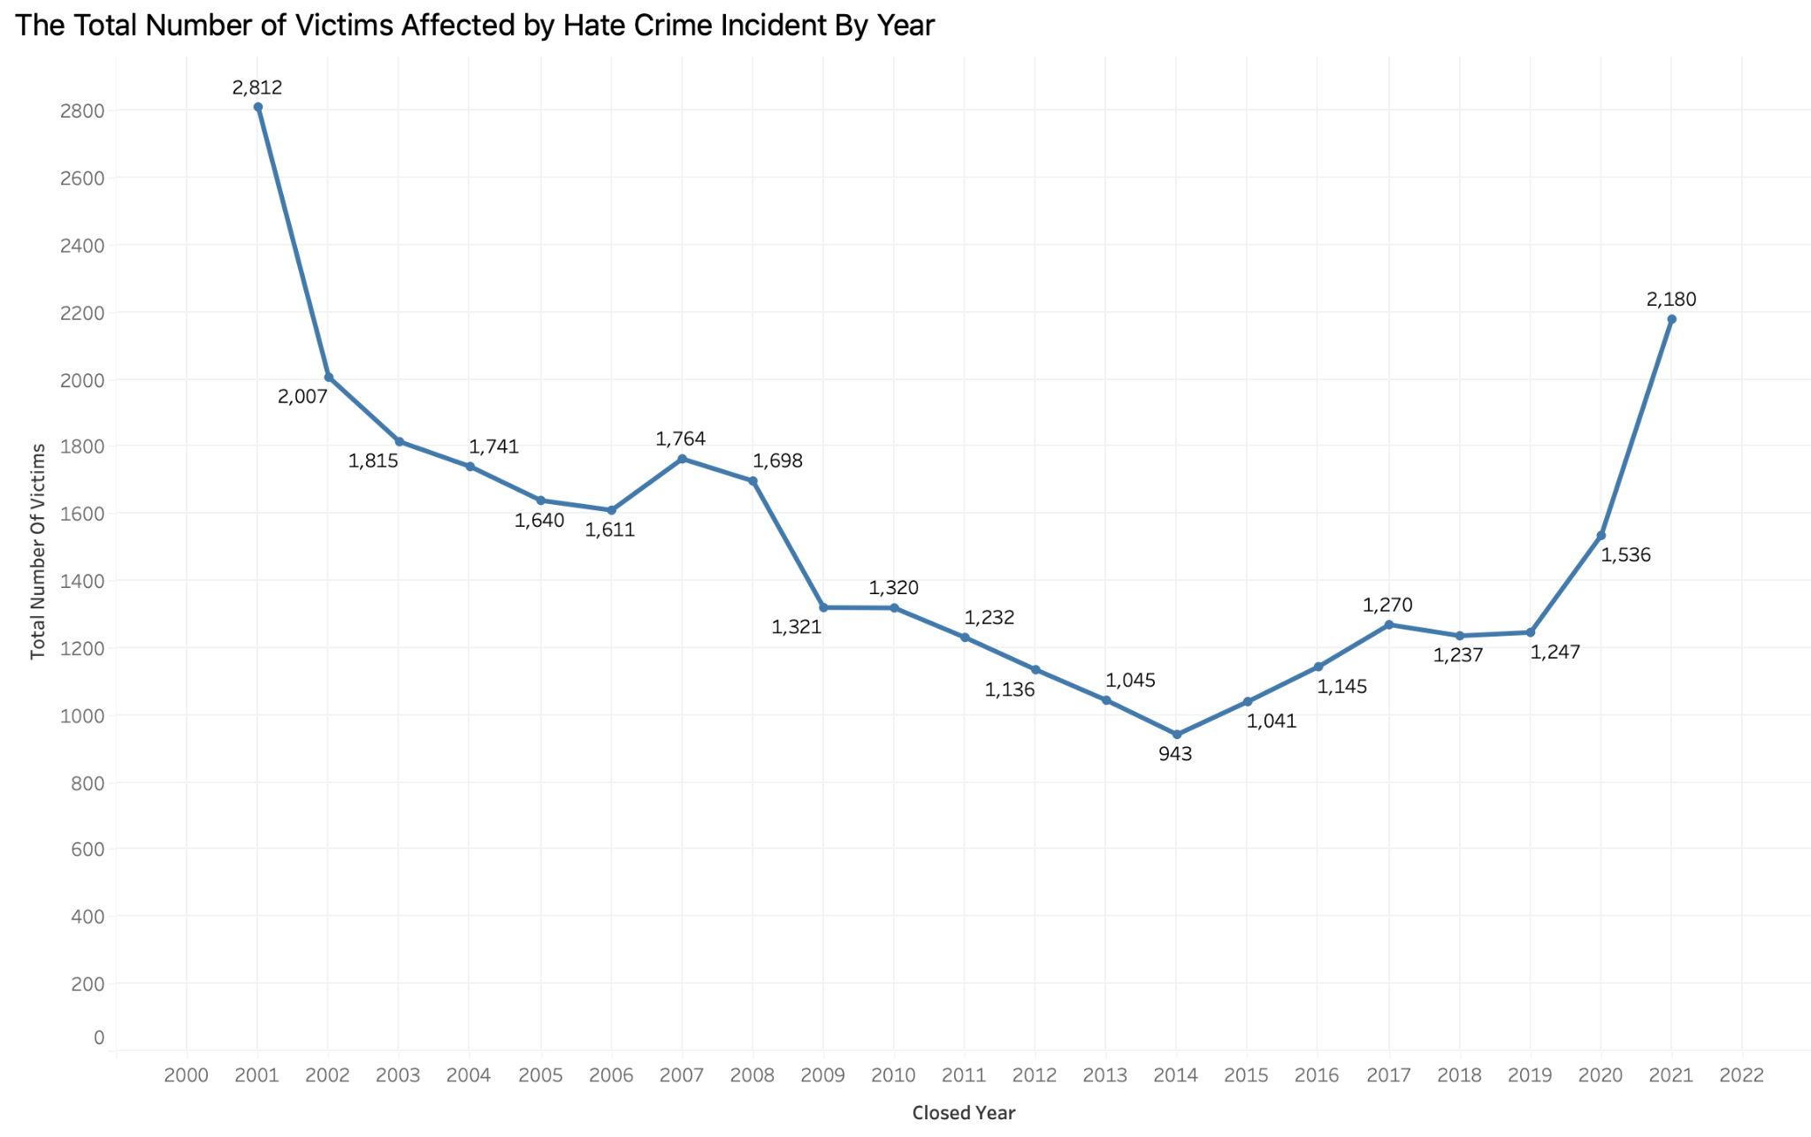
Observation:
Hate crimes were highest in 2001 (2,812 reported hate crimes)
Visible decrease over next 20 years then big jump in 2021 (2,180 reported hate crimes)
Insights:
In 2001, 9/11 occurred which caused a spike in religious hate crimes towards Muslims
In 2021
COVID -19
Police Brutality
Political Agenda
Notes:
brittney

Slide 8
Different Types of Bias Types Within California

Slide 9
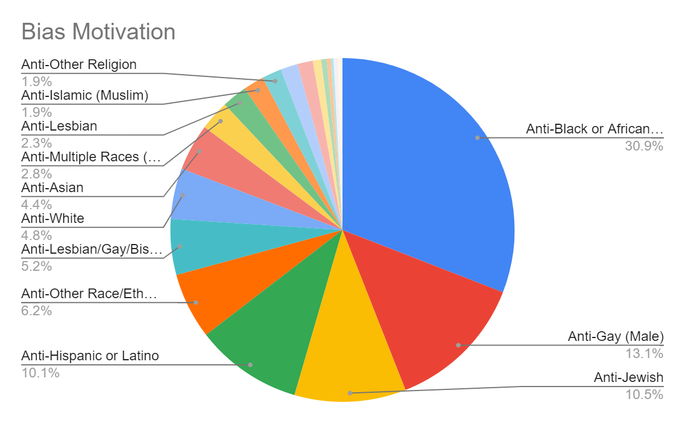
Observations:
Racial bias against African Americans were the highest bias motivation
The second highest bias motivation is anti-gay (males)
Insights:
Racial stereotypes and poor media portrayals may have contributed to racial bias against African Americans
Toxic masculinity, societal gender norms, and oversexualization are underlying reasons behind homophobia
*cases with less than 50 cases reported are not shown

Slide 10
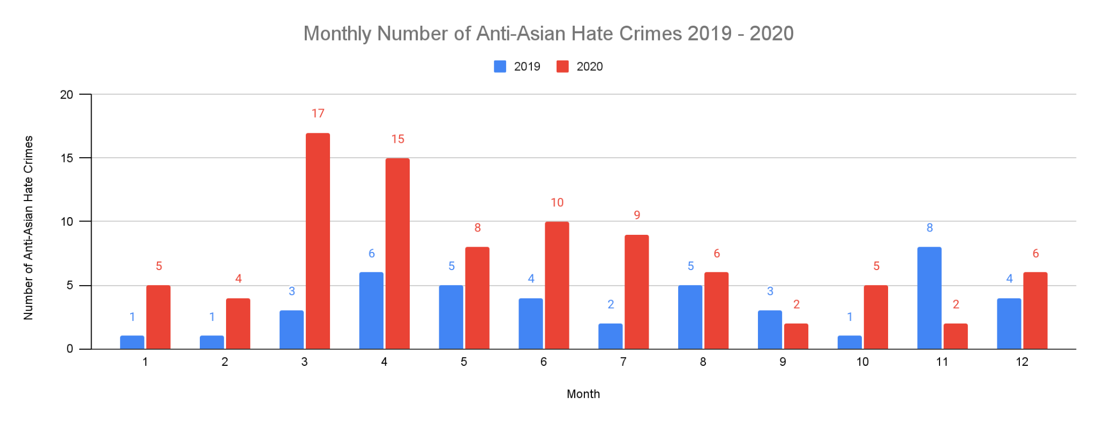
Observations:
Overall 2020 Anti-Asian hate crimes are higher than 2019
Anti-Asian hate crimes increased at the same time there is a COVID-19 surge
A large increase in March and April 2020
Insights:
COVID-19 increased the amount of Anti-Asian hate crimes
States began lockdowns in March 15, 2020 / first wave of COVID-19
Number of reported cases in March 2020 increased by 467% compared to March 2019

Slide 11
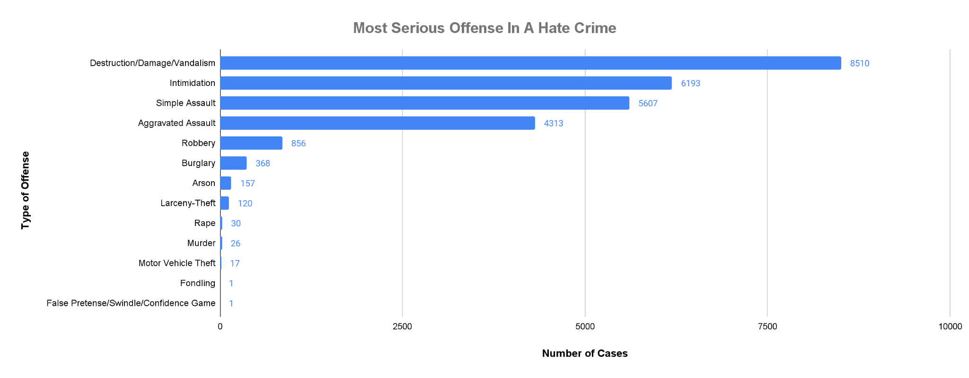
Observations:
Generally less severe offenses such as vandalism and intimidation are most common while more severe offenses such as murder and rape are not as common
Insights:
Less severe offenses are easier to get away (ex: Intimidation, Simple Assault)
Destruction/Damage/Vandalism are the highest because there is less chance of confrontation

Slide 12
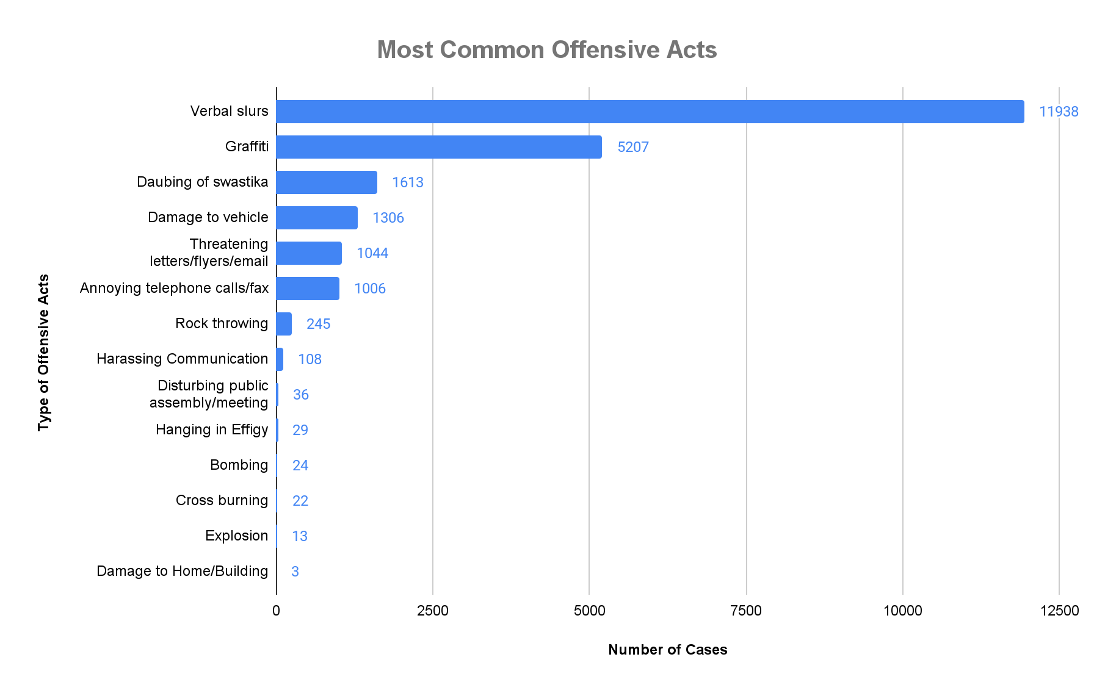
Observations:
Similarly the less severe acts are more common compared to acts that are more severe such as bombing
Acts that may include more people or attract attention are less common
Insights:
Hate crimes that are less severe are more common because victims are less likely to report perpetrators
Perpetrators do not think of or realize the consequences or damage of such acts
*Unknown(71) and Other(3110) are excluded

Slide 13
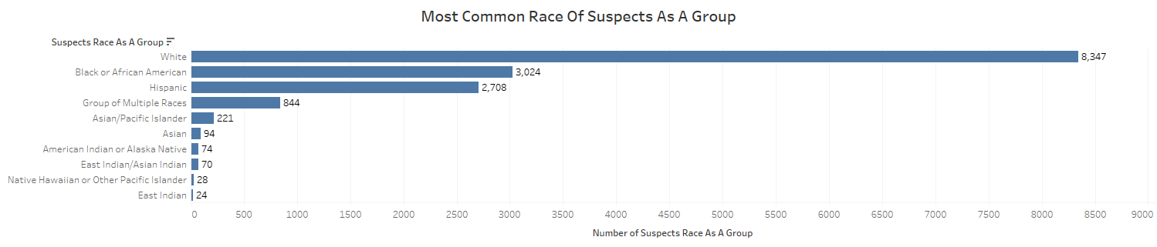
*Unknown(10765) are excluded
Observations:
Whites are the most common race for suspects followed by African American and Hispanic
Insights:
Contrary to what the media shows, most suspects are White and not African American
White Supremacy

Slide 14
Location of Hate Crimes Around California

Slide 15
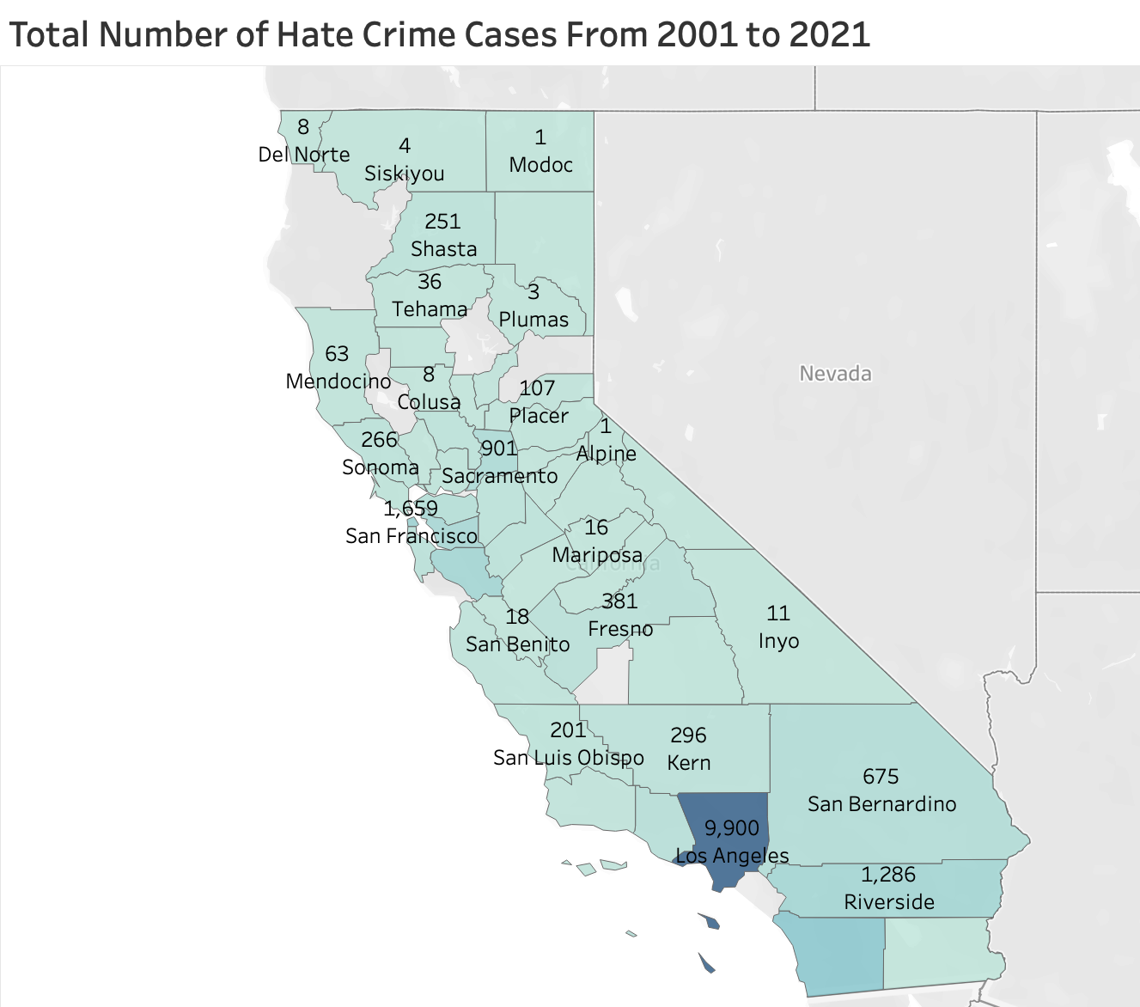
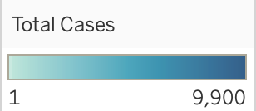
Observations:
From 2001 to 2021, there are total 26,199 cases in California. Los Angeles has highest case number with 9,900 cases (37.8%).
Next is San Diego with 2,420 cases (9.2%) and San Francisco with 1,659 cases (6.3%).
Insights:
Most hate crime incidents mostly occur in bigger cities due to having a more diverse population.

Slide 16
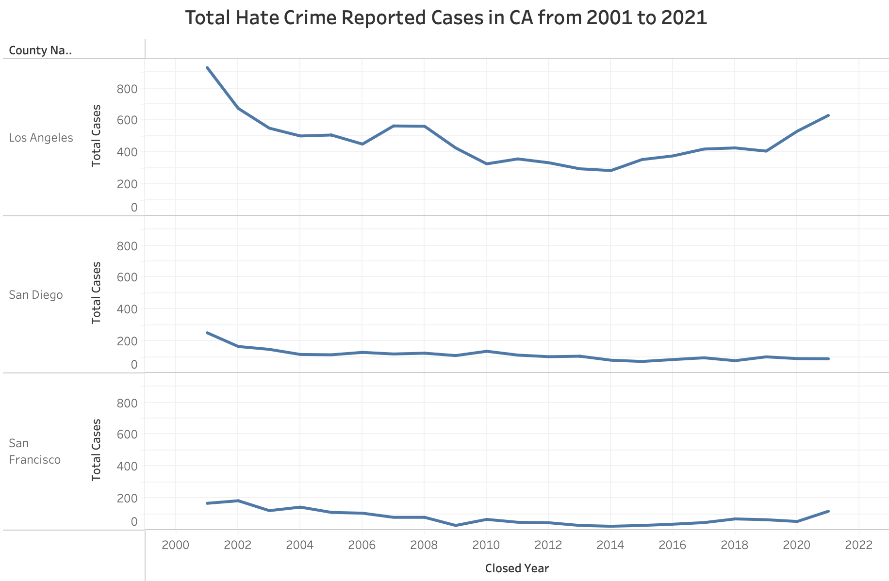
Insights:
Los Angeles is known as the largest county in country with diversity population. It leads to the hate crime incidents between each religion, races.
In 2001, the year of 9/11 attacks, Los Angeles has the highest number of hate crimes in this century (Anti-Muslim, Anti-Jewish) and during COVID-19 pandemic (Anti-Asian) as well.
In 2017, the rise of hate crime against the LGBT community in Los Angeles.

Slide 17
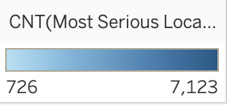
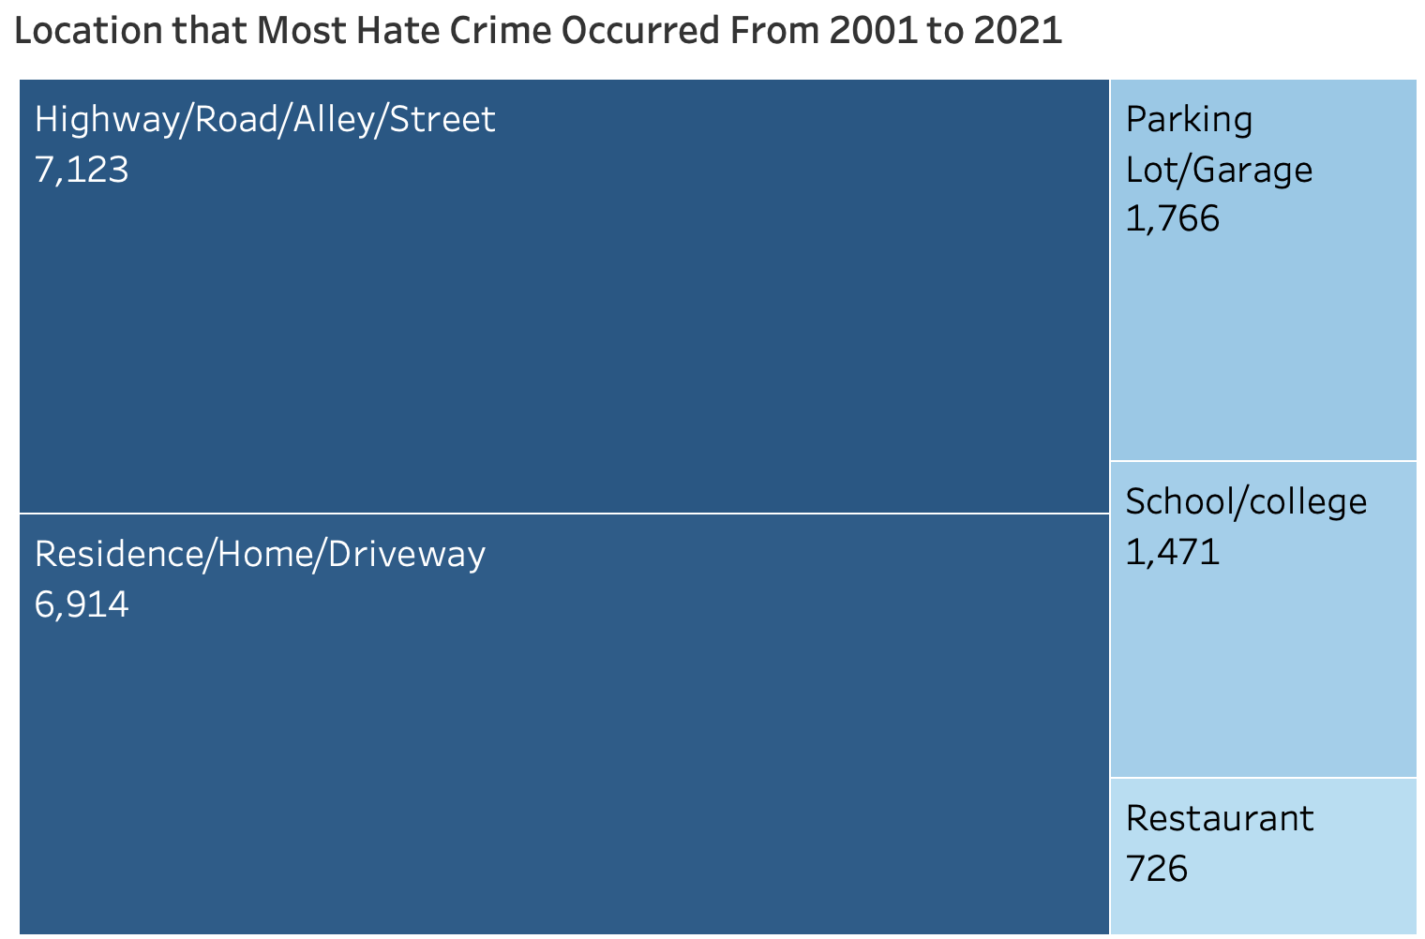
Observations:
Most hate crime incidents occurred in Highway/Road/ Alley/ Street.
Location with the less observation will be the target.
Insights
Road rage occurring on highways/streets.
Not many people on the street and not enough light at night.
Most incidents occurred in the deserted area of some Ethnic communities.
Cases less than 726 have been excluded

Slide 18
Total Number of Weapon Types used in Hate Crimes

Slide 19
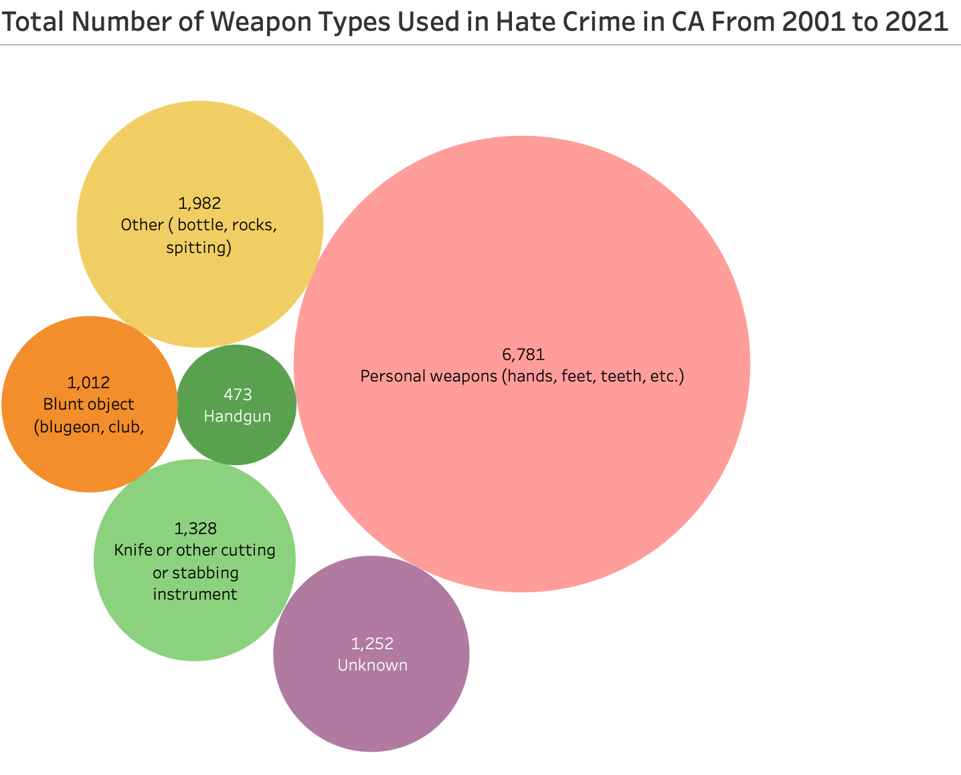
Observations:
Personal weapons (hands, feet, teeth) were used the most as types of weapons.
Random objects (bottles, rocks, spitting) were the second most used weapon.
Insights:
Due to most hate crimes occurring outside, personal weapon would be the most accessible choice of weapons.
People use random items
*Number of cases less than 473 has been excluded.
Notes:
There are various kinds of weapons were used. The weapon type which were used the most is personal weapons (49.1%) and other types (bottle, rocks) - 14.4%.
There are total 13,797 weapon types were recorded from 2001 to 2021.

Slide 20
Recommendations
Starts with yourself and your community
Increase education and awareness of hate crimes within community and school programs
Educate people to work together instead of putting blame on specific groups of people
Education on awareness
Building blocks for a safer community
Report to police
When out in public, be in a group as much as possible
Law enforcement agencies prioritizing hate crimes and publicly addressing them
Sends message to community that discrimation and harassment will not be tolerated
Government officials should be aware of the impact of what they say (i.e. Trump calling COVID-19, “China virus”)
Create anti-hate crime websites for general public, media, and stakeholders
Notes:
Brittney
Should create a website same as www.stopbullying.gov for the general public, media and stakeholders. The website includes federal resources about hate crime law, victim service resources, and agency contacts that can assist victims from hate crime.
Should consider the reason why hate crime victims failed to report to police. The Department of Justice should ensure that the report is safe and efficient for the victims.
Government officials should be aware of what they say (i.e. Trump calling COVID-19, “China virus”)
Increase awareness on how fixing destruction/damage/vandalism is costly
Improve street lightingGovernment officials should be aware of what they say (i.e. Trump calling COVID-19, “China virus”)
Report to police
When out in public, be in a group as much as possible
Educate people to be aware of surroundings
Increase awareness of the damage caused by slurs
Increase awareness on how some races are overrepresented as perpetrators in media
Educate future generations that everyone is equal

Slide 21
Resources
Learn About Hate Crimes. (2022, June 16). Retrieved October 17, 2022, from https://www.justice.gov/hatecrimes/learn-about-hate-crimes
Hate Crimes Rise in U.S Cities and Counties in Time of Division & Foreign Interference| CSUSB. (n.d.). Retrieved October 17, 2022, from https://www.csusb.edu/sites/default/files/2018%20Hate%20Final%20Report%205-14.pdf
The Department of Justice (DOJ) Criminal Justice Statistics Center (CJSC) Hate Context (Dataset), from https://data-openjustice.doj.ca.gov/sites/default/files/dataset/2022-08/Hate-2001-2021.csv

Slide 22
THANKS! ANY QUESTIONS?

